Slide 1

Data Structures and Algorithms Instructor: Maira Sami
maira.sami@szabist.edu.pk
Campus 100
Room No. 101

Slide 2
Lecture 3 Asymptotic notations

Slide 3
Time complexity :
For (i=0; i<n ; i++)
{
Statements;
}
2. For (i=n ; i>0 ; i--)
{
Statements;
}
Find:
O(??)
Notes:
n

Slide 4
3. for(i=0; i<n ; i++)
{
for (j=0; j<n ; j++)
{
statement;
}
}
O(??)
4. for(i=0; i<n ; i=i+2)
{
statement;
}
Notes:
N2
n/2

Slide 5
5. For (i=0; i<n ; i=i*2)
{
statement;
}
O(log n)
6. for(i=n ; i>= 10 ; i=i/2)
{
statement;
}
Notes:
Log2n

Slide 6
summary
for(i=0; i<n ; i=i++) O(n)
for(i=0; i<n ; i=i+2) O(n)
for(i=n; i>1 ; i=i--) O(n)
for(i=1; i<n ; i=i*2) O(log₂ n)
for(i=1; i<n ; i=i*3) O(log₃ n)
for(i=n; i>1 ; i=i/2) O(log₂ n)

Slide 7
Types of Time function:
O(1)---------Constant function
O(log logn)--- double logarithmic
O(log n )------logarithmic function
O((logn)^k)----poly logarithmic
O(n)--------linear function
O(nlogn)---- log linear
O(n²)--------Quadratic function
O(n³)-------- cubic function
O(n^k)---- polynomial
O(2^{n})-------- Exponential
O(n!)--- factorial
Notes:
Increasing growth rate top to bottom

Slide 8
Compare class of functions 1 < log n < √n < n < n log n < n² <n³ ---- < 2^{n} < 3^{n} ---- < n^{n}
Table
Graph

Slide 9
ASYMTOTIC NOTATIONS
Asymptotic Notations are languages that allow us to analyze an algorithm's running time by identifying its behavior as the input size for the algorithm increases. This is also known as an algorithm's growth rate.
There are 3 types of asymptotic notations
O big-oh → upper bound
Ω big- omega → lower bound
Ø theta → average bound

Slide 10
Big –oh
It would be convenient to have a form of asymptotic notation that means "the running time grows at most this much, but it could grow more slowly." We use "big-O" notation for just such occasions.
Given functions f(n) and g(n), we say that f(n)is O(g(n)) if there are positive constant C and n such that
f(n) <= C*g(n) for n>=n₀

Slide 11
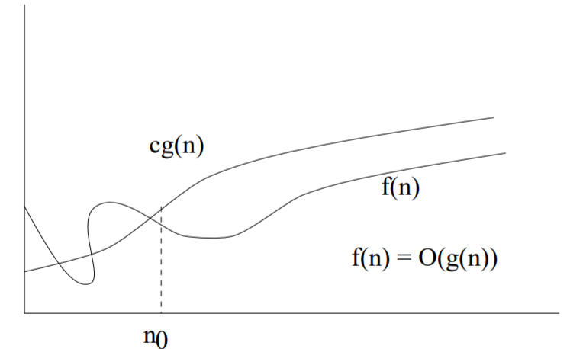
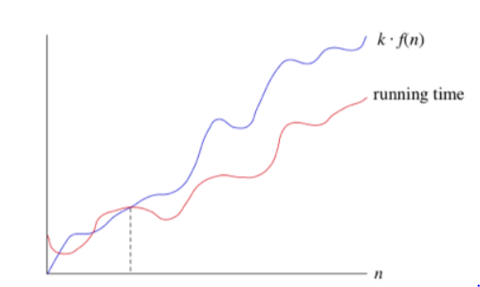

Slide 12
Exercise question
2n+3
2n³+2nlogn³ +5
3 logn +log logn
3¹⁰⁰
^{5/n}
Notes:
N
N3
Logn
1
1/n

Slide 13
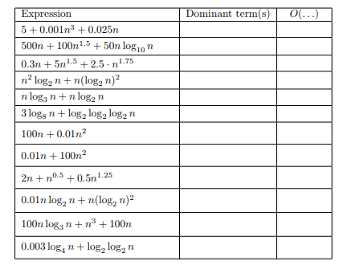
Solve this

Slide 14
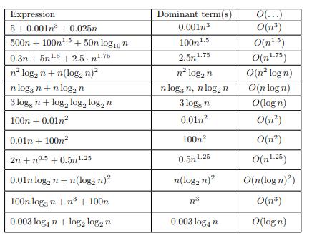

Slide 15
Big-Omega
Sometimes, we want to say that an algorithm takes at least a certain amount of time, without providing an upper bound. We use big-Ω notation; that's the Greek letter "omega."
Given functions f(n) and g(n), we say that f(n)is Ω(g(n)) if there are positive constant C and n such that
f(n) >= C*g(n) for n>=n₀
It provide lower bound of function

Slide 16
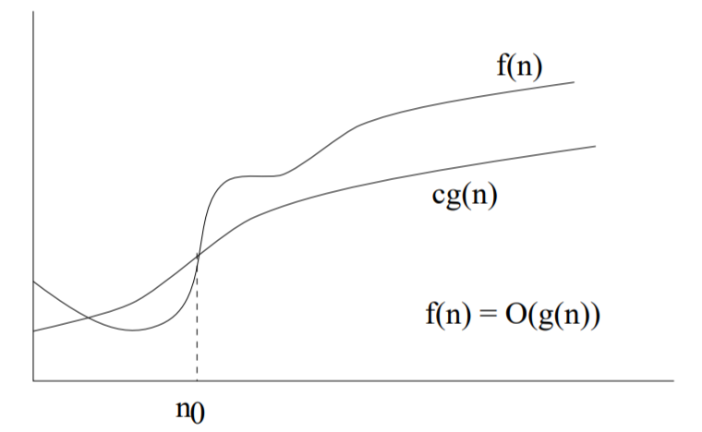
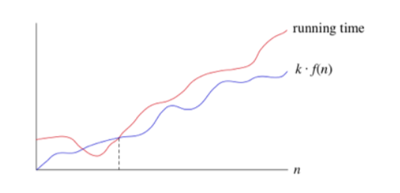

Slide 17
Theta notation
Given functions f(n) and g(n), we say that f(n)is Ø(g(n)) if there are positive constant C and n such that
C2*g(n) <= f(n) <= C1*g(n) for n>=n₀

Slide 18
exercise
1*n <= 2n+3 <= 5n theta ()
F(n) = 2n^2+3n +4 O()
F(n) = 2n^2+3n +4 omega() , theta()
F(n)= n^2 log n + n omega(),theta(), O()
F(n)= n! omega(),theta(), O()
F(n)= logn! omega(),theta(), O()
Notes:
N
N2
N2logn
1,nn

Slide 19
Properties of asymptotic notations
General property
If f(n) is Og(n) then a*f(n) is Og(n)
Same for theta and omega notation

Slide 20
2. Reflexive property :
If f(n) is given that f(n)= O(f(n))
3. Transitive property
If
f(n) is O(g(n)) and g(n) is O(h(n))
then
f(n)=O(h(n))

Slide 21
4.symmetric property:
If f(n) is theta (g(n)) then g(n) is theta (f(n))
5. Transpose property
If f(n) =O(g(n)) then g(n)= Ω (f(n))

Slide 22
6. if f(n) is Og(n) and f(n) is Ωg(n) then f(n) is Øg(n)
7. additive property
8. multiplicative property

Slide 23
Comparison of function

Slide 24
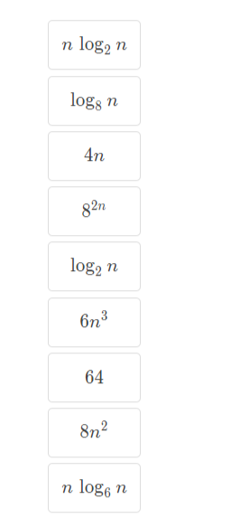
Practice problem : Rank these according to their growth rate

Slide 25
We have several different types of functions
Constant functions
Logarithmic functions
Linear functions
Linearithmic functions
Polynomial functions
Exponential functions

Slide 26
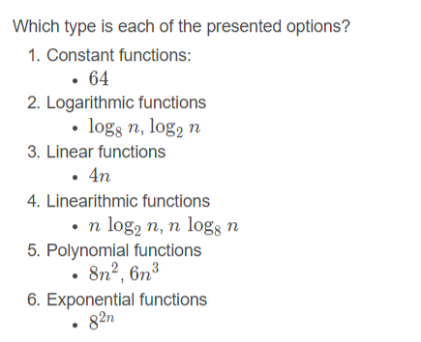

Slide 27
